Slide 1
ITSC 200 – Network Protocols and Security
Linux: Filesystem

Slide 2
Objectives
Learn about the Linux filesystem permissions
Be able to use absolute and relative paths
Be able to identify and use symbolic links
Check free space and available partitions in the file system
Understand Users and Groups in Linux

Slide 3
Linux Files
All filenames and directory names in Linux are case-sensitive.
The file Myfile.txt is different than myfile.txt is different than myfile.TXT
A good practice is to keep file names all lowercase.
Using spaces and special characters in filenames or directories is bad, and if you use them you will have to re-do your work during coffee break. On a test, it will earn you a 0.
Yup. It is that bad.

Slide 4
Linux Files
Do not create text files in Windows and try to copy them to Linux. You can do it, but Linux and Windows treat text files differently and you will have very annoying and perplexing problems.
File and directory names should be unique.
Files don’t need an extension.
So a text or executable can be simply one name like “resume”
We normally add extensions to make the purpose of the file more clear.
resume.doc

Slide 5
Linux Files
Creating files is a simple as touching them.
Go ahead.
touch myfile
touch Myfile.txt
touch my.txt
touch hisfile.txt
touch abc
touch Myfile.doc
touch hi.txt
touch h1.txt

Slide 6
Linux Files
When we refer to files in a command, we can use wildcards to refer to more than one file at a time.
The “*” character in a filename refers to 1* or more characters.
Myfile.txt , my.txt , hisfile.txt would all be captured using *.txt
Myfile.doc would not be captured
The “?” character in a filename refers to exactly 1 character.
My.txt , hi.txt, h1.txt would be captured by ??.txt
M.txt , abc.txt , h25.txt, zz.TXT would not be captured.

Slide 7
Linux Files
You can even use brackets [] to match any occurrence of a character enclosed within the brackets!
h[12].txt would capture h1.txt or h2.txt
h[0-9] would capture any file started with h, followed by a single digit!
*[678] would match any file that ends in 6 or 7 or 8
It can get a bit tricky when you start using the wildcards together
Can you predict what files “?org.[0123].*” would capture ?

Slide 8
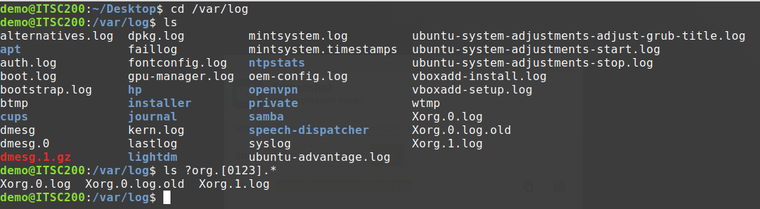
ls ?org.[0123].*

Slide 9



A little bit of Access Control
Meet Alice
And her new computer

Slide 10
A little bit of Access Control
Alice was not worried.
It was the early 60’s.
She was the only one using the computer.
The Operating System and the File System were “simple”
She was the owner of her files.
She could do anything.
read
write
execute

Slide 11

A little bit of Access Control
Meet Bob
Alice’s computer
and Alice’s files!

Slide 12
A little bit of Access Control
Alice is a little bit worried.
She is no longer the only one using the computer.
But she still is the computer administrator.
How can she prevent Bob from looking at her files?

Slide 13

A little bit of Access Control
Lets create a table keep track of the files and which users can do what on each file!
User | File 1 | File 2 | File 3 | File 4 | File 5
Alice | r, w | r, w | r, w, x | r, w | x
Bob | r | r |  | x | r

Slide 14


A little bit of Access Control
Meet Cris & Dilan
Alice’s computer
and Bob and Alice’s files!

Slide 15
A little bit of Access Control
Now Alice is worried.
They have over 9000 files!
She has to manage the permission for all files, and the size of her access control matrix has just doubled in a single day!
User | File 1 | File 2 | File 3 | … | File 9075
Alice | r, w | r, w | r, w | … | r
Bob | r | x |  | … | r, w
Cris |  | r | r | … | x
Dilan | r, w | r | r | … | x

Slide 16
A little bit of Access Control
Having Alice handle the permissions is unfair! Let file owners decide who gets access to their files!
User | File 1 | File 2 | File 3 | … | File 15750
Alice | OWNER | r, w | r, w | … | r
Bob | r | x |  | … | OWNER
Cris |  | OWNER | r | … | x
Dilan | r, w | r | OWNER | … | r

Slide 17
A little bit of Access Control
Now Alice is very worried.
The owner of a file can choose the permissions for the file.
But we are still using that “messy” table to keep track of things.
What if we keep adding new users?
The complexity of managing permissions has not changed.
It merely changed hands.

Slide 18


A little bit of Access Control
Meet Eli & Karldoggo
Family’s computer
and the family’s files!

Slide 19
A little bit of Access Control
Now Alice is extremely worried.
Even the dog is using the computer.
What is he using it for?
The family has grown, she can’t even remember the name of all the people who use the computer.

Slide 20
A little bit of Access Control
It’s time to simplify things Let’s separate the users into groups and let specific groups have access to the files.
Group | File 1334 | File 2355 | File 3134 | … | File 15750
Parents | r, w, x |  |  | …
Kids |  |  |  | … | r, w, x
Visitors |  | r, w, x |  | …
Animals |  |  | r, w, x | …

Slide 21

Kids
Visitors
Parents
Animals

Slide 22
A little bit of Access Control
Adding new users to groups is easier than adding users to the access control table.
Groups don’t change very often.
It is now impossible to assign individual permissions.
File owners are mad.
Alice is mad.
The kids are mad.
BAD DOG!

Slide 23
A little bit of Access Control
Maybe it is time to compromise. Not everyone can get what they want, but we can come to an agreement.
What if we keep the individual rights of the file owners and use groups for ease of management?
And by the way, that table is using too much memory and that’s why the computer is slow.

Slide 24
Moral of the story
There are different filesystem access control models.
Depending on the needs of the organization.
Depending on the Operating System.
File permissions used in Linux are identical and derived directly from UNIX.
Sometimes this model is called the traditional Unix permissions system
Each model has advantages and disadvantages.

Slide 25
Linux Filesystem Permissions
A file will have permissions for:
the User who owns the file
the Group who owns the file
the Other users
There are three different permissions:
read
write
execute

Slide 26
Filesystem Permissions
User / Owner
Usually the user that created the file but we can change that with the chown command. There can only be one user owner.
Group
The group owner. This can be any built-in group or groups created by the administrator (root). There can only be one group owner.
Others / World
Any authenticated user. They don’t need to belong to any particular group.

Slide 27
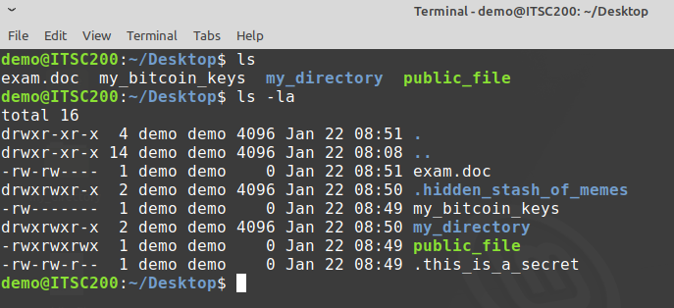
Filesystem Permissions
Permissions
User
Group
Name

Slide 28
Filesystem Permissions
Permissions are represented using three, 3-bit groups that are stored in the file system itself, not in the operating system.
User |  |  | Group |  |  | Other
r | w | x | r | w | x | r | w | x
4 | 2 | 1 | 4 | 2 | 1 | 4 | 2 | 1
Symbolic
7
7
7
Numeric
3-bit
3-bit
3-bit

Slide 29
Filesystem Permissions
User |  |  | Group |  |  | Other
r | w | x | r | w | x | r | w | x
4 | 2 | 1 | 4 | 2 | 1 | 4 | 2 | 1
7
7
7
chmod 751 filename
User |  |  | Group |  |  | Other
r | w | x | r | - | x | - | - | x
4 | 2 | 1 | 4 | - | 1 | - | - | 1
7
5
1

Slide 30
Filesystem Permissions
User |  |  | Group |  |  | Other
r | w | x | r | - | x | - | - | x
4 | 2 | 1 | 4 | - | 1 | - | - | 1
7
5
1
So, in the above example, the owner would have full permissions, the group would have read and execute, and other users would only have execute permissions.

Slide 31
Filesystem Permissions

Slide 32
chmod command
We can use the chmod command to change the permissions of a file.
chmod 751 filename
Sets rwx to the user owner, rx to the group and x to the others.
chmod 666 filename
Sets rw to the user, the group and the others.
chmod 600 filename
Sets rw to the user and nothing to the group and to the others.

Slide 33
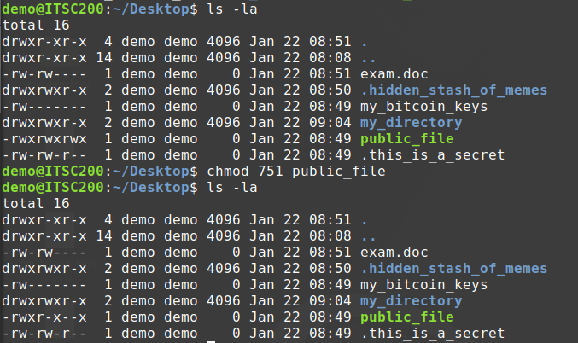
chmod command

Slide 34
chmod cheat sheet
Number | rwx triplet value | Description
0 | --- | No permissions
1 | --x | Execute
2 | -w- | Write
3 | -wx | Write and execute
4 | r-- | Read
5 | r-x | Read and execute
6 | rw- | Read and write
7 | rwx | Read, write and execute

Slide 35
chmod command
We can also set permissions using the symbolic format.
chmod +x filename
Gives x permission to everyone
chmod u+rwx, g+r filename
Gives rwx to the user owner and r to the group
chmod u+rwx, g+rwx, o+rwx filename
Gives rwx to the user owner, group and others

Slide 36
chmod command
The use of the –R option (means “recursive”) when setting the permissions on a directory will change the permissions for the directory and all of the files and directories under it.
chmod –R 755 directory
Will change the permissions of the directory and everything inside the directory to rwx for the user, rx for the group and others.

Slide 37
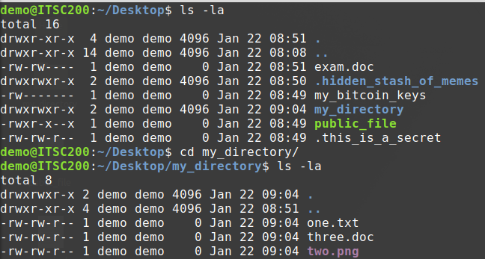
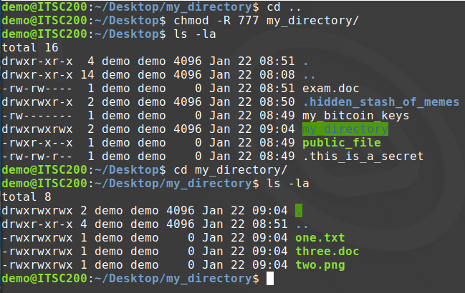
chmod command

Slide 38
Traversing directories
In the Linux and UNIX basic file system, a user must have execute permission on a directory in order to enter it.
If they have execute-only permission on a directory, without having read permission, they will be able to go into the directory but will not see any files or directories, even if they are present in the directory.
Windows does this by assigning the “right to traverse” security setting to a user.

Slide 39
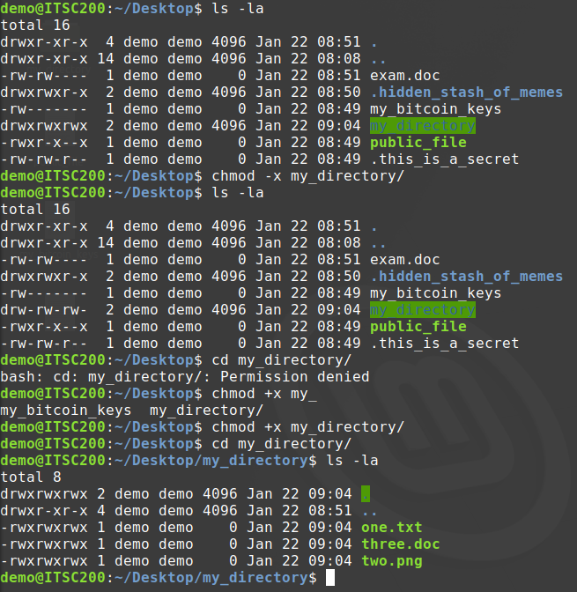

Slide 40
Absolute Paths
Always has a “/” at the beginning, meaning that you always specify the path from the root of the file system.
Safest way to specify a path in scripts and programs.
Must be careful that the path actually exists.
Beware of mistakes like “rm –rf /*” . What would this command do ?

Slide 41
Relative Paths
Never have a “/” at the beginning.
Are always relative to your current directory.
Special cases:
“cd ~” will return you to your home directory from anywhere
“cd ..” will move your current directory up one level
“cd ../..” will move your current directory up two levels
“cd ../../..” will move your current directory up three levels

Slide 42
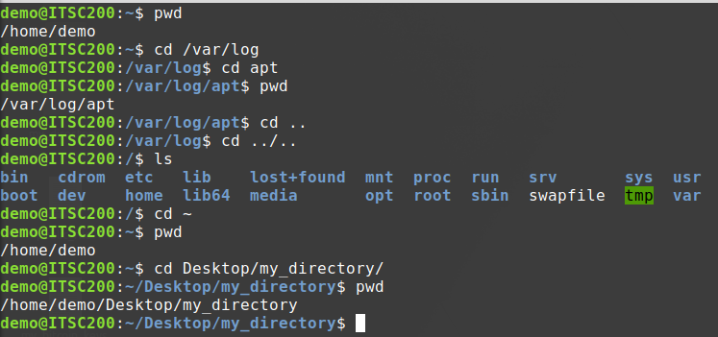

Slide 43

Coffee Break!

Slide 44
Symbolic Links
Much like “shortcuts” in Windows.
There are actually two kinds of links in Linux
Hard links
Soft links
Users rarely ever use hard links but soft links can be quite useful.
If a soft link is deleted, the file or directory that it points to is unaffected.
If the target of the soft link is deleted or moved, the soft link is unaffected … but of course won’t work.

Slide 45
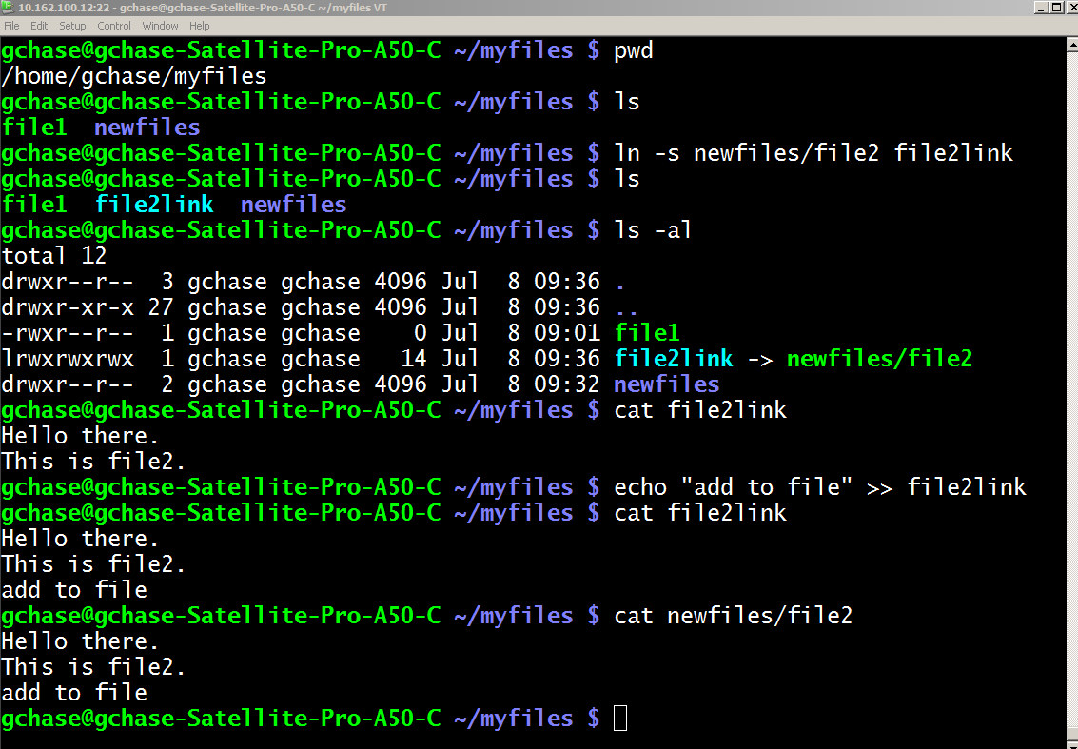

Slide 46
Symbolic Links
Symbolic links are often used for things like collecting all of the system log files in one location.
Sometimes a program is poorly coded and needs to have a particular file in a particular location in order to run. This can easily be remedied with a symbolic link to the target file in the location the program expects to find the file.
We can have multiple symbolic links to the same file or directory.
Permissions on the symbolic link are meaningless. The target permissions always apply.

Slide 47
Checking the Filesystem
We use the “df” command to show us how much unused disk space we have.
df as in disk free.
We use the “du” command to show us how much used disk space we have.
du as in disk used.
Both of these commands show results for each partition.
Both commands are commonly used with the “-h” option so that it displays space in appropriate units.

Slide 48
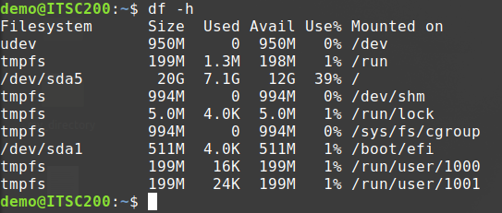
df -h

Slide 49
Checking the Filesystem
We can easily check space use in specific directories by limiting how far down our “du” command goes.
We can also specify many other parameters that allow us to quickly find large files or directories by specifying a threshold size.

Slide 50
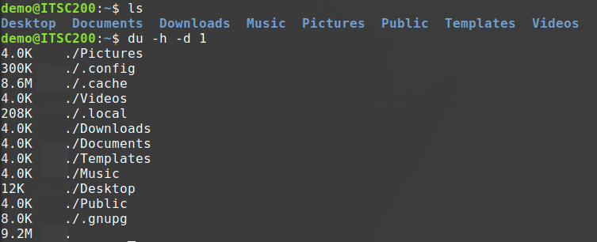
du –h –d 1

Slide 51
Users and Groups
Linux identifies users by name and by User ID (UID)
Linux identifies groups by name and by Group ID (GID)
The default administrative user is called “root”
Root has a UID of “0” and Ubuntu does not let you log in as root. Instead it forces you to precede any privileged command with the “sudo” command.

Slide 52
Users and Groups
User information is stored in /etc/passwd
User passwords are stored in /etc/shadow
Users are added to the Linux system by using the useradd command which has many options.
Most Linux distributions also have a script (adduser) that is more commonly used which is interactive and has some sensible defaults.

Slide 53
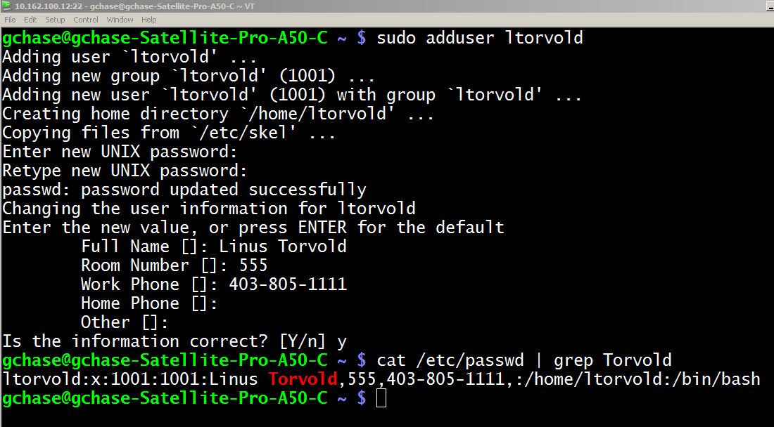

Slide 54
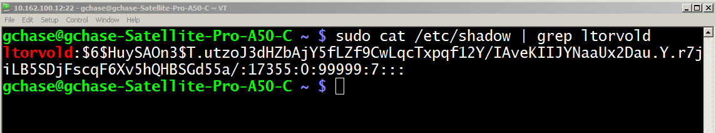
/etc/shadow
As already mentioned, the user’s passwords (in hashed form) are stored in the /etc/shadow file that only root can read.

Slide 55
/etc/shadow
Yes.
John the ripper.

Slide 56
Groups
To give other users different access to directories than the owner has, you will have to use groups.
each file or directory can only have one group.
users can be members of many groups.
We can then add existing users to the group and give them permissions to a directory by giving the directory group permissions.

Slide 57
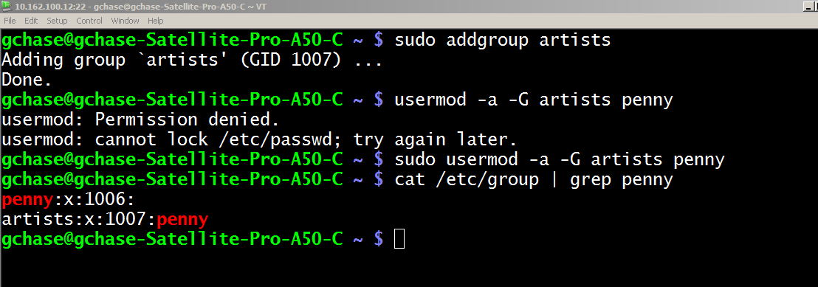

Slide 58
Changing Directory and File Ownership
We use the chown and the chgrp commands to change the user owner and the group owner of a file or directory.
Setting permissions and ownership on individual files is generally considered poor administrative practice.
We usually set permissions on directories and force the permissions down using the recursive option (-R).

Slide 59
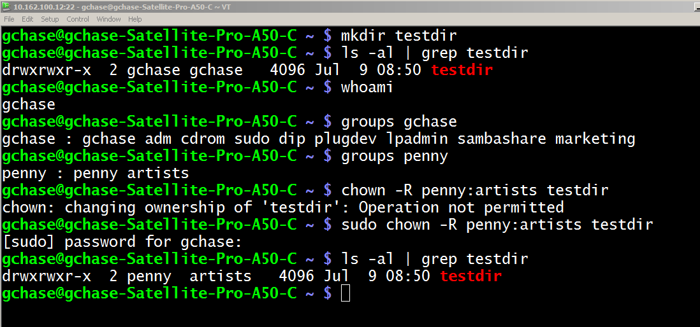

Slide 60
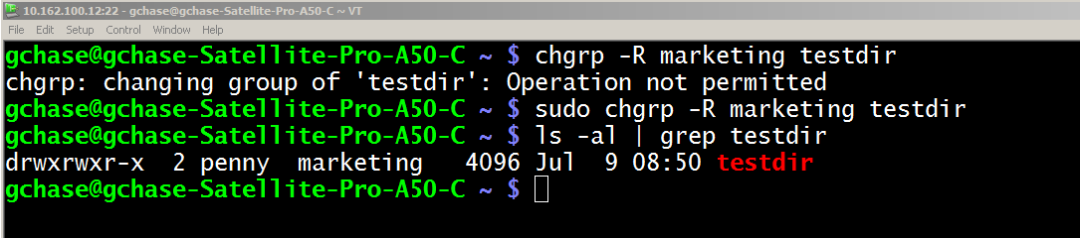
Changing Directory and File Ownership
We can use the chgrp command if we only want to change the group owner.
NOTE that the user owner of a file or directory does NOT need to be a member of the group owner of the same directory.

Slide 61
Done

